Slide 1
ME759 High Performance Computing for Applications in Engineering [Spring 2020]
Lecture 04
01/29/2019
Dan Negrut, 2020 ME759 UW-Madison

Slide 2
Quote of the day
“The real question is not whether machines think, but whether men do.”
-- Burrhus Frederic Skinner, Professor of Psychology at Harvard University [1904 – 1990]

Slide 3
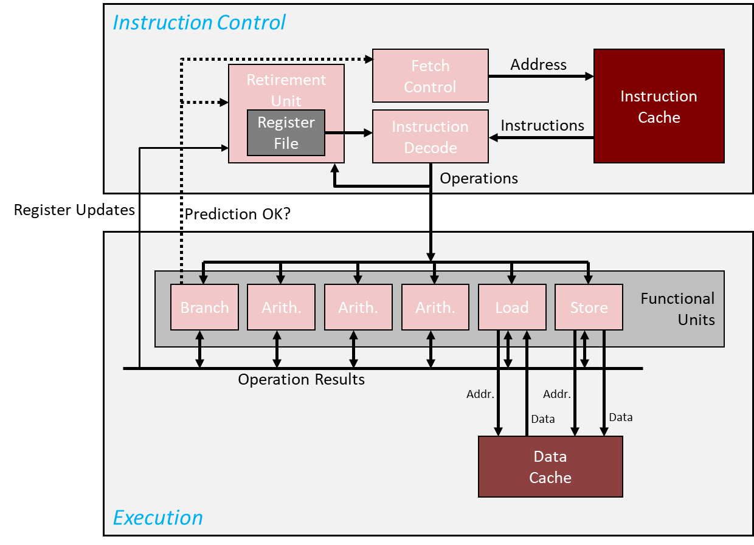
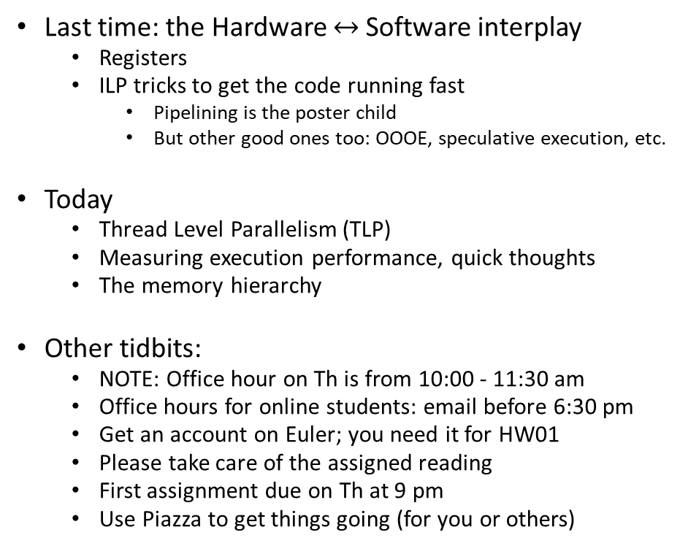
Before we get going…
Last time: the Hardware $↔$ Software interplay
Registers
ILP tricks to get the code running fast
Pipelining is the poster child
But other good ones too: OOOE, speculative execution, etc.
Today
Thread Level Parallelism (TLP)
Measuring execution performance, quick thoughts
The memory hierarchy
Other tidbits:
NOTE: Office hour on Th is from 10:00 - 11:30 am
Office hours for online students: email before 6:30 pm
Get an account on Euler; you need it for HW01
Please take care of the assigned reading
First assignment due on Th at 9 pm
Use Piazza to get things going (for you or others)
Keep this pic in mind when you visualize how your code gets executed, instruction by instruction

Slide 4
Thread Level Parallelism (TLP) [happens on a single core]
ILP not the only “parallel” show in town
Another one: chip executes simultaneously instructions from different processes or different threads
Called Thread-Level Parallelism (TLP)
Important to keep in mind: we are talking about parallelism on one hardware core, not multicore

Slide 5
ILP vs. TLP: how are they different
Recall concept of “Program Counter” (PC): a register that holds address of next instruction
If all instructions executed by the chip in parallel are associated with one PC, we have ILP
TLP: the stream of instructions processed by the chip associated with more than one PC

Slide 6
Process vs. thread – getting a bit into the weeds [1/2]
TLP: chip executes simultaneously instructions from different processes or different threads
Examples:
TLP is what happens when two processes such as Matlab and Microsoft Word run on the chip
Because two different processes, there are two different PCs
TLP: two (or even more) OpenMP or POSIX threads simultaneously run on the chip
Because two different threads, there are two different PCs

Slide 7
Process vs. thread – getting a bit into the weeds [2/2]
How similar: Both processes and threads are independent sequences of execution
How different:
Threads (of the same process) run in a shared memory space
This is how shared-memory parallel computing takes place. Like OpenMP
Processes run in separate memory spaces
This is how distributed-memory parallel computing takes place. Like MPI*
What is a memory space?
To be continued, in one week (after discussing the concept of Virtual Memory)

Slide 8
Why did folks come up with this TLP idea?
Over time, transistor budget ballooned
Owing to Moore’s Law
As such, many Functional Units available
TLP allows us to put them to good use

Slide 9
An example of TLP: Intel’s HTT feature
Typical Intel core supports the “Hyper-Threading Technology” (HTT)
HTT: two threads/processes, each seeing its own stream of machine instructions, active at any given time
“active”: also called “in flight”
The scheduler tries to issue instructions from both processes, at the same time
The beefing up of the CU/ALU hardware required to support HTT is actually pretty minor
Extra hardware required to save execution state of a thread when idle and not running (for lack of data or available functional units)
[Intel]→
Notes:
Intel HT Technology improves performance through increased instruction level parallelism by having two threads with independent instruction streams, eliminating data dependencies between threads and increasing utilization of the available execution units. This effect typically increases the number of instructions executed in a given amount of time within a core, as shown in Figure 3. The impact of this greater efficiency is experienced by users as higher throughput (since more work gets completed per clock cycle) and higher performance per watt (since fewer idle execution units consume power without contributing to performance). In addition, when one thread has a cache miss, branch mispredict, or any other pipeline stall, the other thread continues processing instructions at nearly the same rate as a single thread running on the core. Intel HT Technology augments other advanced architectural features, higher clock speeds, and additional cores with a capability that is relatively inexpensive in terms of space on the silicon and production cost.

Slide 10
Intel’s HTT Feature
In general, TLP requires the participation of the Operating System (OS)
The OS sees one physical chip as two virtual chips; OS “talks” to both of them
Is HHT helpful?
Yes: when running two modestly demanding processes
Example: Running MS-Word and Spotify at the same time
Execution threads are independent, when one execution thread stalls the other can be picked up and its PC advanced
No: high performance computing, when one stream of instruction saturates the memory bandwidth
Nothing left for anybody else to step in and nibble on excess-hardware leftover
NOTE: as of recently, the trend has been for TLP to be scaled back owing to security issues
Notes:
Intel HT Technology improves performance through increased instruction level parallelism by having two threads with independent instruction streams, eliminating data dependencies between threads and increasing utilization of the available execution units. This effect typically increases the number of instructions executed in a given amount of time within a core, as shown in Figure 3. The impact of this greater efficiency is experienced by users as higher throughput (since more work gets completed per clock cycle) and higher performance per watt (since fewer idle execution units consume power without contributing to performance). In addition, when one thread has a cache miss, branch mispredict, or any other pipeline stall, the other thread continues processing instructions at nearly the same rate as a single thread running on the core. Intel HT Technology augments other advanced architectural features, higher clock speeds, and additional cores with a capability that is relatively inexpensive in terms of space on the silicon and production cost.

Slide 11
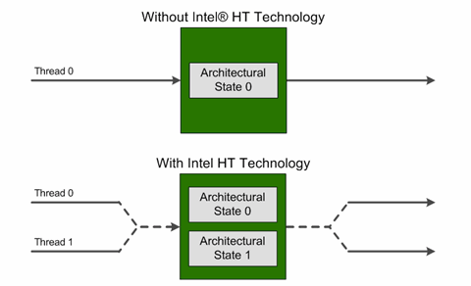
HTT, Intel’s perspective
Highlights:
The processor core maintains two architectural states, each of which can support its own execution thread
Many of the internal microarchitectural hardware resources are shared between the two threads
[Intel]→
Notes:
DAN - Lots of good stuff here: https://software.intel.com/en-us/articles/performance-insights-to-intel-hyper-threading-technology (article by Antonio Valles (Intel))

Slide 12
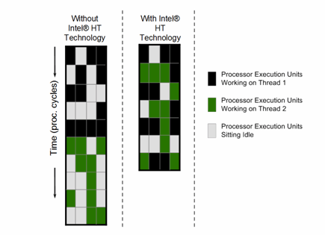
HTT: The Bottom Line
Essentially, one physical core shows up as two virtual cores
Why is it good?
More execution units within the ALU are used at any given time
Higher utilization rate of the hardware assets
When one execution thread stalls (has a cache miss, branch mispredict, pipeline bubble, etc.), the other execution thread continues processing instructions at nearly the same rate as a single thread running on the core
NOTE: HTT is one manifestation of what TLP
IBM, AMD (Zen micro-architecture) do it too
[Intel]→
Notes:
DAN - Lots of good stuff here: https://software.intel.com/en-us/articles/performance-insights-to-intel-hyper-threading-technology

Slide 13
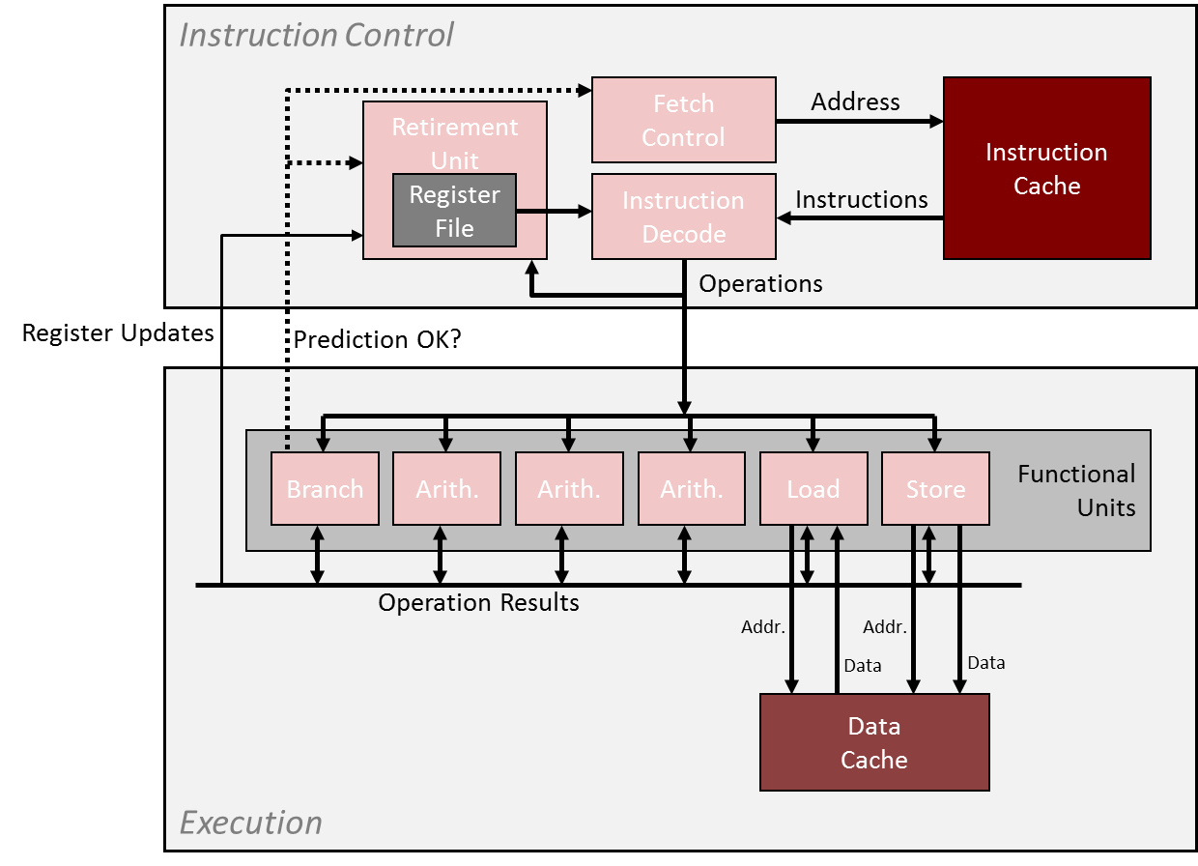
TLP: further discussion
Multi-threading, a possible taxonomy (Hennessey & Paterson)
Coarse grain multi-threading
Fine grain multi-threading
Simultaneous multi-threading
This taxonomy: It all goes back to what goes through this pipe at each clock cycle
The “brain”
The “executioner”

Slide 14
Coarse multi-threading
The Instruction Control issues instructions from one thread for many cycles
Bursts of tens or hundreds of instructions
Instruction Control switches to issuing from another thread only when the first thread runs into a long-latency operation
Examples: cache miss, interrupt, etc.
“long-latency”: Hundreds of cycles or so
!!!!!

Slide 15
Fine multi-threading
Instruction Control can issue instructions from a different thread each cycle
“Barrel-gun style” processing: thread from where next instruction is picked for execution can change at every cycle
GPU computing similar to this
More nimble/sophisticated compared to coarse multi-threading
!!!!!

Slide 16
Simultaneous multi-threading
Simultaneous multi-threading is like fine multi-threading with one caveat:
Instruction Control can issue instructions from different threads in the same cycle
NOTE:
Intel’s HTT is a “simultaneous multi-threading” technology
!!!!!

Slide 17
Superscalar processor or TLP processor. Wrapping it up
Superscalar vs. TLP
Superscalar: instructions associated with one PC
TLP: instructions associated with two PCs
Superscalar: one PC on the chip
HW has the means to execute more than one instruction per cycle
Superscalar: it’s more than a “scalar”; i.e., one thread
TLP: Processor handles instructions from different threads/processes
NOTE: we are not talking about multiple-cores; we are still talking about one CPU core here

Slide 18
Measuring Speed of Execution

Slide 19
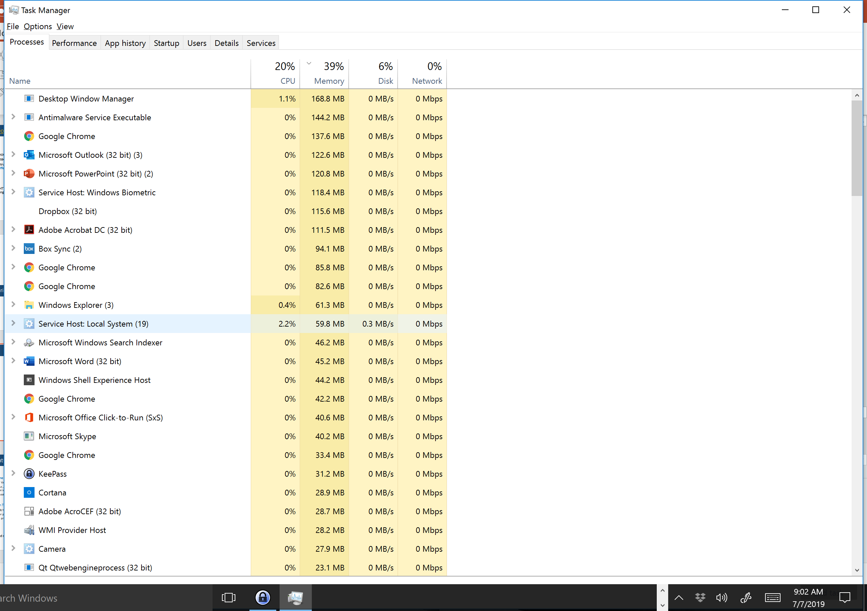
Backdrop: CPU/OS juggle many programs at the same time
The hardware-software interplay:
CPU is hardware
The operating system (OS) is software

Slide 20
Nomenclature (1/3)
Wall Clock Time
Amount of time from the beginning of a program to the end of the program
Includes; i.e., factors in, all the housekeeping (running other programs, OS tasks, etc.) that CPU does while running our program
Perhaps most meaningful indicator of performance since this is what you see
CPU Execution Time
Counts only the amount of time that is effectively dedicated to *your* program
Many other programs running on your machine at the same time (time slicing)
Requires a profiling tool to assess (like gprof, for instance)
On a dedicated machine; i.e., a quiet machine, Wall Clock Time and CPU Execution Time should be identical
[Patterson, 4th edition]→
Notes:
In general: Program Execution Time is what you care about (end-to-end time to solution)

Slide 21
Nomenclature (2/3)
Qualifying CPU Execution Time further:
User time – the time spent processing instructions compiled out of code generated by the user or in libraries that are directly called by user code
System time – time spent in support of the user’s program but in instructions that were not generated out of code written by the user
OS support: open file for writing/reading, throw an exception, etc.
The line between the user time and system time is somewhat blurred, sometimes hard to delineate and differentiate
“system vs. user”: We bother to delineate since we can only cut into the “user time”; you can’t rewrite system code

Slide 22
Nomenclature (3/3)
Clock cycle, cycle, tick – the length of the period for the processor clock
Clock cycle: sets the pace at which the execution proceeds
In a pipeline process, in a perfect scenario, each clock cycle sees the completion of one instruction
A constant value dictated by the frequency at which processor operates
Examples:
A 1 GHz processor has clock cycle of 1 nanosecond
A 2 GHz processor has clock cycle of 0.5 nanoseconds (500 picoseconds)

Slide 23

The CPU Performance Equation
Three ingredients control the amount of time for execution of a program:
Number of instructions that your program has (Instruction Count)
Average number of “clock-cycles per instructions” (CPI)
Clock Cycle Time
The CPU Performance Equation reads:
Alternatively, using the clock rate
$CPU Execution Time=Instruction Count ×CPI ×Clock Cycle Time$
$$CPU Execution Time= \frac{Instruction Count ×CPI}{Clock Rate}$$
[Patterson, 4th edition]→

Slide 24
CPU Performance: How can we improve it?
$CPU Execution Time=Instruction Count ×CPI ×Clock Cycle Time$
To improve performance the product of three factors should be reduced
For a long time, we’ve piggy backed on “let’s increase the frequency”; i.e., reduce clock cycle time
We eventually hit a wall this way (the “Power Wall”)
As repeatedly demonstrated in practice, reducing the Instruction Count (IC) often times leads to an increase in CPI. And the other way around.
Notes:
Power Wall relationship: power dissipation is proportional to frequency
RISC: large IC, small CPI
CISC: small IC, large CPI
Tweaking CPI – the goal of ILP (but that seems to have exhausted its capabilities: “ILP wall”)
Parallel computing: do more of this in parallel

Slide 25
Side Trip: Revisiting, RISC or CISC?
Ongoing argument – whether RISC or CISC is the better ISA
The former is simple and therefore can be optimized easily. Yet it requires a large number of instructions to accomplish something in your C code
High IC but low CPI
The latter is complex but instructions are expressive. Leads to few but expensive instructions to accomplish something in your C code
Low IC but high CPI
Specific example: ARM vs. x86

Slide 26
SPEC CPU Benchmarks
Benchmarks help us understand what processor does well what
Idea: gather a collection of programs that use a good mix of instructions and flex the muscles of a chip
The “collection of programs”:
Should be non-trivial and widely used
Should be as objective as possible: not favor a chip manufacturer at the expense of another one
Example: a compiler is used extensively, so it makes sense to have it included in the benchmark
Two common benchmarks:
Tied to programs dominated by floating point operations: CFP2006
Tied to programs dominated by integer arithmetic: CINT2006
Notes:
SPEC: Standard Performance Evaluation Corporation (non-profit)
Different processors are better at different things.

Slide 27
SPEC CPU Benchmark: Example, highlights AMD performance
CINT2006 Programs |  | AMD Opteron X4 – 2356 (Barcelona)
Description | Name | Instruction count [×10⁹] | CPI | Clock Cycle Time [seconds ×10⁻⁹] | CPU Exec. Time [seconds]
Interpreted string processing | perl | 2118 | 0.75 | 0.4 | 637
Block-sorting compression | bzip2 | 2389 | 0.85 | 0.4 | 817
GNU C compiler | gcc | 1050 | 1.72 | 0.4 | 724
Combinational optimization | mcf | 336 | 10.00 | 0.4 | 1,345
Go game (AI) | go | 1658 | 1.09 | 0.4 | 721
Search gene sequence | hmmer | 2783 | 0.80 | 0.4 | 890
Chess game (AI) | sjeng | 2176 | 0.96 | 0.4 | 837
Quantum computer simulation | libquantum | 1623 | 1.61 | 0.4 | 1,047
Video compression | h264avc | 3102 | 0.80 | 0.4 | 993
Discrete event simulation library | omnitpp | 587 | 2.94 | 0.4 | 690
Games/path finding | aster | 1082 | 1.79 | 0.4 | 773
XML parsing | xatancbmk | 1058 | 2.70 | 0.4 | 1,143
[Patterson, 4th edition]→

Slide 28
SPEC CPU Benchmark: Example, wrap up
There are programs for which the CPI is less than 1.
Suggests that multiple issue is at play
Why are there programs with CPI of 10?
The pipeline stalls a lot, most likely due to repeated cache misses and system memory transactions
[Patterson, 4th edition]→
Notes:
Program with CPI=10 : combinatorics, likely many memory accesses “all over the place”. This segues in the next segment, where we will discuss memory-related issues.

Slide 29

Important, common sense observation
You get the brownie points for writing code whose instructions fly through the chip
Nobody particularly impressed by instructions that take a long time to execute

Slide 30
Big New Topic: Memory Aspects

Slide 31
Transistors: why we love them and want to have lots of them
Transistors used to make the CU and ALU work
Transistors also used for memory, to store data and instructions (focus on this aspect next)

Slide 32
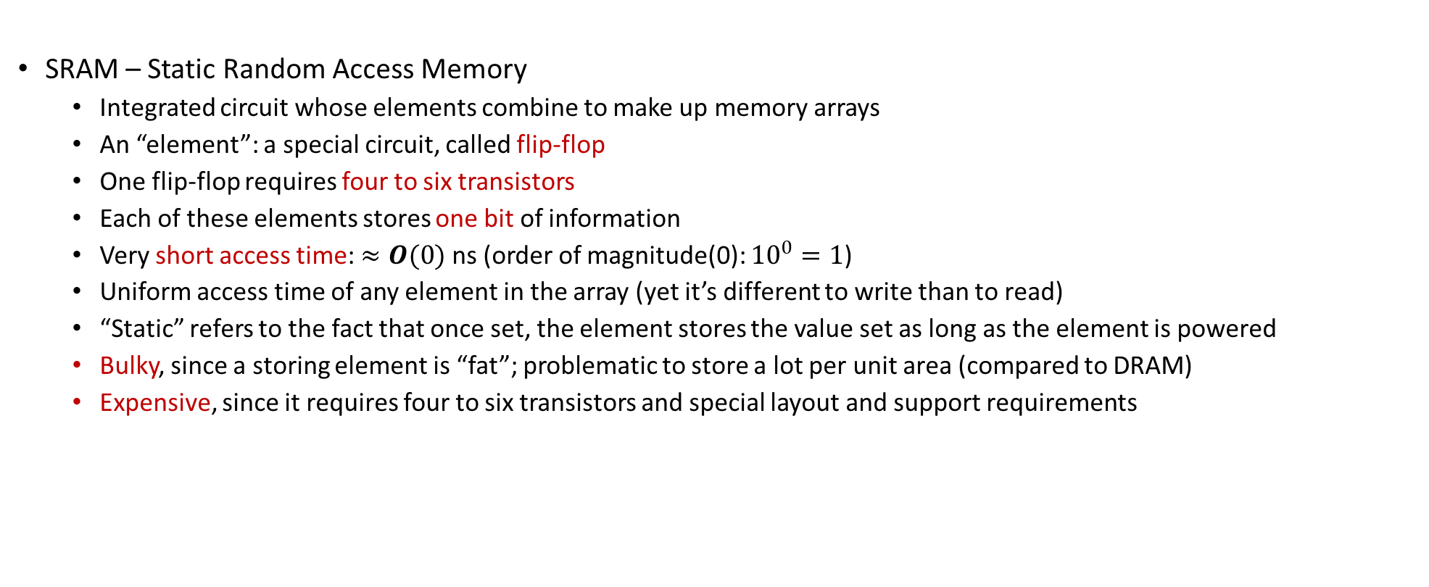
SRAM: significant consumer of transistors
SRAM – Static Random Access Memory
Integrated circuit whose elements combine to make up memory arrays
An “element”: a special circuit, called flip-flop
One flip-flop requires four to six transistors
Each of these elements stores one bit of information
Very short access time: $≈O(0)$ ns (order of magnitude(0): ${10}^{0}=1$)
Uniform access time of any element in the array (yet it’s different to write than to read)
“Static” refers to the fact that once set, the element stores the value set as long as the element is powered
Bulky, since a storing element is “fat”; problematic to store a lot per unit area (compared to DRAM)
Expensive, since it requires four to six transistors and special layout and support requirements
[Patterson & H]→
Notes:
SRAM is an integrated circuit whose elements combine to make up memory arrays.
In figure: the memory chip can store 4 million 32 bit data.
For 4 million addresses: 2^22, you need address lines.
Data in/out: 8 + 8
Additionally, need 3 control lines (Chip select, Write enable, Output enable)

Slide 33
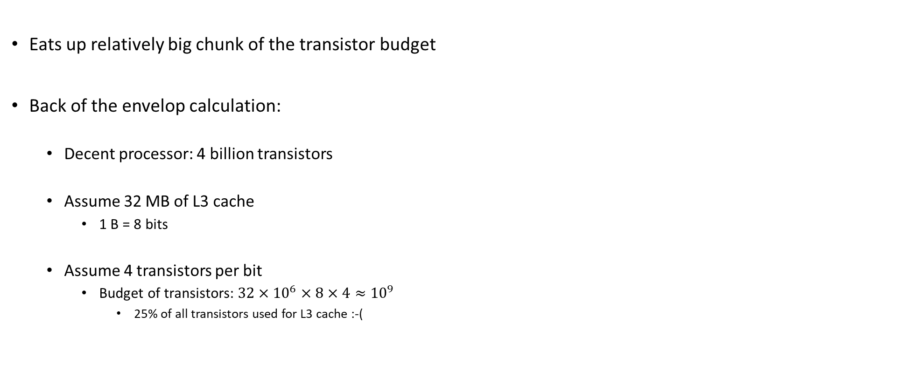
SRAM: It’s Expensive
Eats up relatively big chunk of the transistor budget
Back of the envelop calculation:
Decent processor: 4 billion transistors
Assume 32 MB of L3 cache
1 B = 8 bits
Assume 4 transistors per bit
Budget of transistors: $32×{10}^{6}×8×4≈{10}^{9}$
25% of all transistors used for L3 cache :-(

Slide 34
DRAM
DRAM type memory: the information stored as a charge in a capacitor
No charge: 0 signal
Some charge: 1 signal
The good: cheap, requires only one capacitor and one transistor
The bad: capacitors leak, so the charge or lack of charge should be reinforced every so often, dynamically
D in DRAM comes for the “dynamically” attribute
Moral of the story: State of the capacitor should be refreshed every millisecond or so
Refreshing requires a small delay in memory accesses
Is this delay incurred often? (first order approximation answer)
Given frequency at which memory is accessed, refreshing every millisecond means issues might appear once every million cycles
Moral of the story: refresh is a rare event (in the life of the execution cycle)
[Patterson & H]→

Slide 35
SRAM vs. DRAM: wrap-up
SRAM access time: of the order of nanoseconds or tens of nanoseconds
Expensive but fast
Transistor hog
Needs no refresh
DRAM access time: of the order of hundreds of nanoseconds
Less expensive but slow
Higher capacity per unit area
Needs refresh every 10-100 ms
Sensitive to disturbances
Limit case: a 100X speedup if you can work off the SRAM
 | Transistors per bit | Access Time | Persistent? | Sensitive? | Price | Applications
SRAM | 6 | 1X | Yes | No | 100X | Cache memories
DRAM | 1 | 100X | No | Yes | 1X | Main Memory
[Rauber&Runger]→
Notes:
[Rauber&Runger]→ Typical access times are 0.5–2.5 ns (ns = nanoseconds = 10−9 seconds) compared to 50–70 ns for DRAM (values from 2008 [84])
From Rochester (http://www.cs.rochester.edu/~sandhya/csc252/lectures/lecture-storage.pdf):
Key features
– RAM is packaged as a chip.
– Basic storage unit is a cell (one bit per cell).
– Multiple RAM chips form a memory.
• Static RAM (SRAM)
– Each cell stores bit with a six-transistor circuit.
– Retains value indefinitely, as long as it is kept powered.
– Relatively insensitive to disturbances such as electrical noise.
– Faster and more expensive than DRAM.
• Dynamic RAM (DRAM)
– Each cell stores bit with a capacitor and transistor.
– Value must be refreshed every 10-100 ms.
– Sensitive to disturbances.
– Slower and cheaper than SRAM.

Slide 36
Feature Comparison Between Memory Types
 | SRAM | DRAM | Flash
Speed | Very fast | Fast | Very slow
Density | Low | High | Very high
Power | Low | High | Very low
Refresh | No | Yes | No
Retention | Volatile | Volatile | Non-volatile
Mechanism | Bi-stable Latch | Capacitor | Fowler-Nordheim tunneling
Notes:
Flash memory: Toshiba (1980)
Uses “floating-gate transistors”

Slide 37
New Topic: The Memory Hierarchy
Common Sense Observations
Observation 1: over time, speed of data processing increased faster than speed at which we could bring over data to be processed
Observation 2: the bigger the memory used to store data, the longer it takes to find/access an entry therein
Compromise between size and speed of access

Slide 38
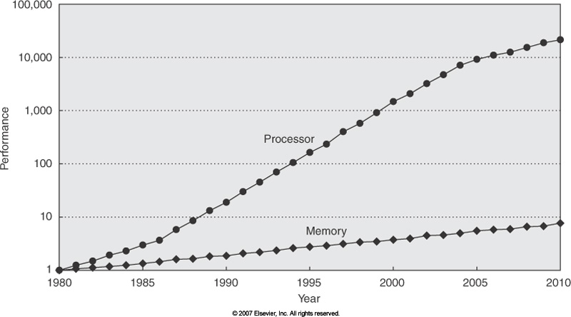
Backdrop: Widening of the Processor-DRAM Speed Gap
Courtesy of Elsevier, Computer Architecture, Hennessey and Patterson, fourth edition
Notes:
QUESTION: we talk about memory wall as an impediment to continuing increase in sequential computing performance and we said that the problem is that memory cannot keep up feeding the raw number crunching capability of the CPU.
But then, how can parallel computing be the answer? How could memory serve now multiple “consumers” and yet overall performance increase?
To explain this, we note that memory performance is related to two key concepts:
latency
bandwidth

Slide 39
Consequences of common sense observations
Consequences of Observations 1 & 2: a hierarchy of memories has emerged
It took some time to shape up, happened through a continuous improvement process
Managing the hierarchy not trivial → a dedicated hardware asset called MMU (memory management unit) handling this task
MMU’s purview: cache control, virtual memory management, memory protection, bus arbitration, etc.

Slide 40
The memory hierarchy, how it shapes up
Since SRAM is expensive and bulkier, can’t have too much
Plagued by space & cost constraints
Compromise:
Have some SRAM on-chip, making up what is called the “cache”
Have a lot of inexpensive DRAM off-chip, making up the “main memory”
This is what people have in mind when they ask you “How much memory does your system have”?
In our code, we hope to have low “average memory access time” by hitting the cache repeatedly instead of taking costly trips to main memory
Notes:
A single issue pipelined processor that operates at 2 GHz could in theory execute one instruction every 0.5 nanoseconds. SRAM has access times in that range; DRAM memory has access times about 50 times slower. In an ideal world, one would have all data available in SRAM so that the processor can work at capacity. Since SRAM is expensive and bulky only a small amount is available in the processor to store both data and instructions. This small amount of memory is called cache memory.

Slide 41
There’s even a cache hierarchy…
Simplest memory hierarchy:
Main Memory + One Cache (typically called L1 cache)
Today’s memory architectures typically have deeper hierarchy: L1+L2+L3
L1 faster and smaller than L2
L2 faster and smaller than L3
All caches are typically on the chip and are SRAM
Notes:
L1 also uses “better components” than L2

Slide 42
Typical Memory Hierarchy
[Bryant and O‘Hallaron: Computer Systems - A Programmer's Perspective 3rd edition] →
L0:
Regs
CPU registers hold words retrieved from the L1 cache.
Smaller,
faster,
and
costlier
(per byte)
storage
devices
L1:
L1 cache
(SRAM)
L1 cache holds cache lines retrieved from the L2 cache.
L2:
L2 cache
(SRAM)
L2 cache holds cache lines
retrieved from L3 cache
L3:
L3 cache
(SRAM)
L3 cache holds cache lines
retrieved from main memory.
Larger,
slower,
and
cheaper
(per byte)
storage
devices
L4:
Main memory
(DRAM)
Main memory holds disk blocks retrieved from local disks.
L5:
Local secondary storage
(local disks)
Local disks hold files retrieved from disks
on remote servers
L6:
Remote secondary storage
(e.g. file servers)

Slide 43
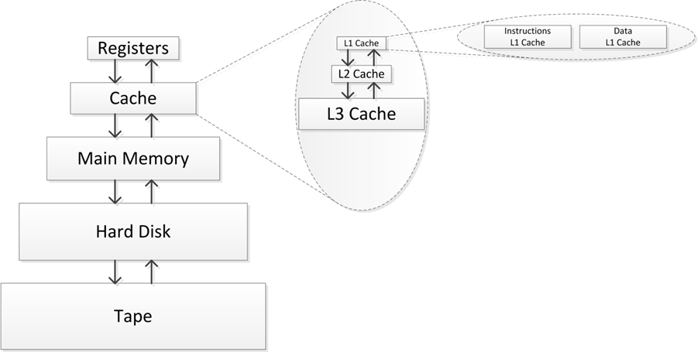
Memory Hierarchy
Moving on to talk about caches

Slide 44
Cache Memories
Cache memories are small, fast, on-chip SRAM-based memories
Purpose: to store close to the CU/ALU frequently accessed blocks of main, or system, memory
Typical system structure:
CPU chip
Register file
ALU
Cache
memory
System bus
Memory bus
Main
memory
Bus interface
I/O
bridge
[Bryant and O‘Hallaron: CMU] →

Slide 45
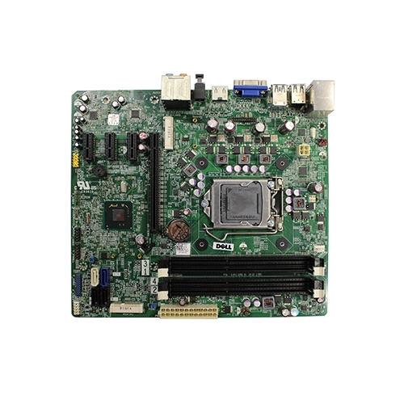

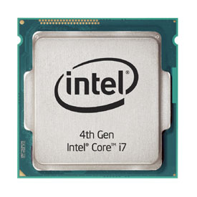
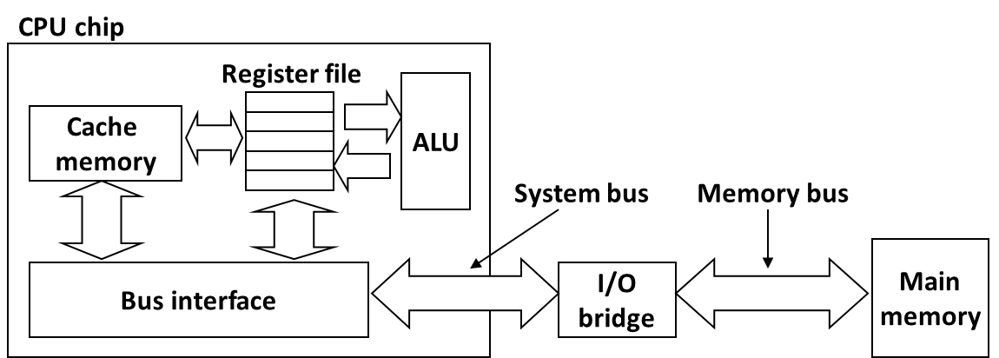
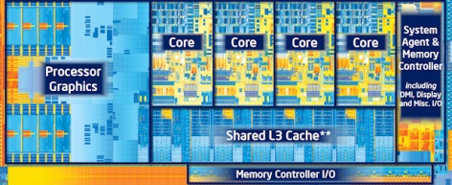
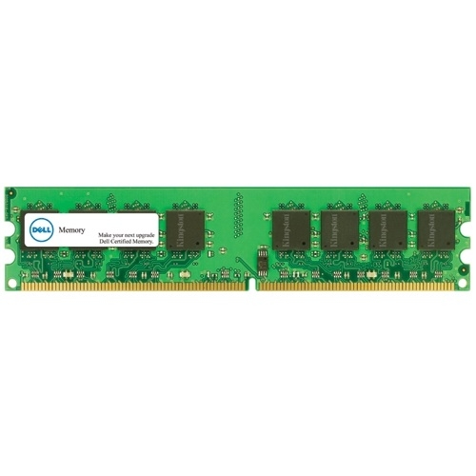
What it Really Looks Like
Motherboard
Source: Dell
Desktop PC
CPU (Intel Core i7)
Gets dropped in here
Source: PC Magazine
Source: Dell
Main memory (DRAM)
Source: techreport.com
Source: Dell
[Bryant and O‘Hallaron: CMU] →

Slide 46
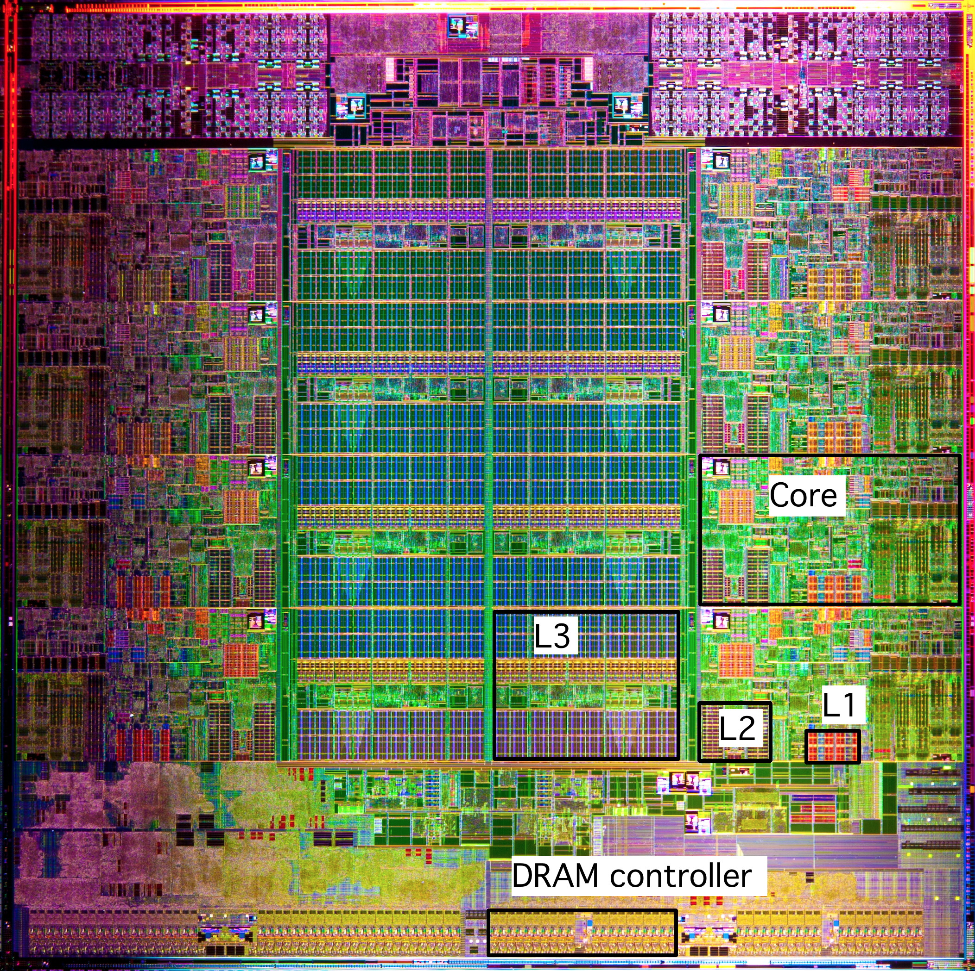
What it Really Looks Like [contd.]
Intel Sandy Bridge-E
Processor Die
[8 core-version]
CPU chip
Register file
ALU
Cache
memory
Bus interface
L1: 32KB Instruction + 32KB Data
L2: 256KB
L3: 5–20MB
[Bryant and O‘Hallaron: CMU] →

Slide 47
How Cache Comes into Play
All* read/write operations go through cache
Caches used to hold both data and instructions
Data and instructions caches are in general different
Intel: L1 DC (data cache) and L1 IC (instruction cache) have been distinct since of 1993
CPU Core
Cache
Bus
Main Memory

Slide 48
Caches: Come In Two Flavors
Data caches feed processor with data manipulated during execution
If processor would rely on data provided by main memory the execution would be pitifully slow
“Processor Clock” much faster than the “Memory Clock”
Caches alleviate the memory pressure – processors are data hungry
Instruction caches: used to store instructions
Simpler to deal with compared to the data caches
By and large, instruction use is much more predictable than data use

Slide 49
Processor Clock vs. Memory Clock
From RAM
Processor Clock: (look for the box )
Dictates/defines the frequency at which Functional Units operate
Memory Clock:
Dictates/defines the frequency used to move data into/out from main memory into cache
To/From RAM

Slide 50
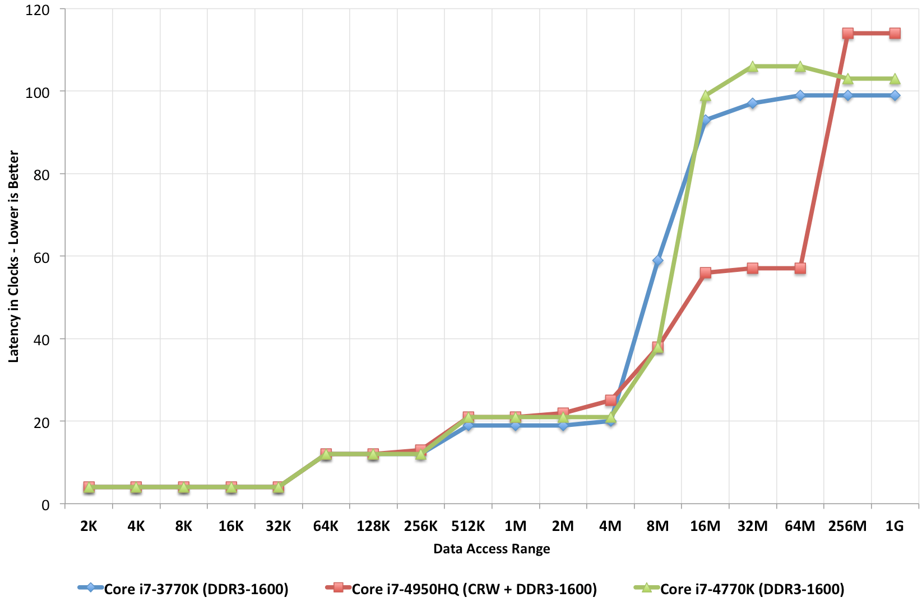
Caches: How large? Also, how fast?
Ratio between cache size and main memory size
Reasonable to expect something like 1:1000
2013: 4 MB of L3 cache, versus 4 GB of main memory
2017: 55 MB of L3 cache, versus 64 GB of main memory
This is the overhead of a system memory access (about 100+ cycles)
Vintage: 2013 (related to Intel’s Haswell)
Latency in Clocks –Lower is Better
This chip has L4 cache, read more about it here
(log scale)

Slide 51
Multiple Levels of Cache
Commodity chips today have 3 cache levels
(some chips have a fourth cache level, see previous slide)
CPU Core
L1 D$
L1 I$
L2 Cache
L3 Cache
Bus
Main Memory

Slide 52
Intel Core i7 Cache Hierarchy
Processor package
Core 0
Core 7
Regs
Regs
L1 i-cache and d-cache:
32 KB, 8-way assoc.
Access: 4 cycles
L2 unified cache:
256 KB, 8-way assoc.
Access: 10 cycles
L3 unified cache:
8 MB, 16-way assoc.
Access: 40-75 cycles
Block size: 64 bytes for all caches.
L1
d-cache
L1
i-cache
L1
d-cache
L1
i-cache
…
L2 unified cache
L2 unified cache
L3 unified cache
(shared by all cores)
Main memory
[Bryant and O‘Hallaron: Computer Systems - A Programmer's Perspective 3rd edition] →

Slide 53
Why Caches Work: the “Principle of Locality”
Principle of Locality: Programs tend to use data and instructions with addresses near or equal to those they have used recently
Temporal locality:
“Recently referenced items are likely to be referenced again in the near future”
Spatial locality:
“Items with nearby addresses tend to come into use together”
[Bryant and O‘Hallaron: Computer Systems - A Programmer's Perspective 3rd edition] →

Slide 54
Spatial and Temporal Locality
Temporal Locality for memory access by a program
Idea: If you access a variable at some time, then you’ll probably keep accessing the same variable for a while
Example: a for loop with some variables inside the loop → you keep accessing those variables as long as you loop
Spatial Locality for memory access by a program
A memory access pattern characterized by bursts of repeated requests for data that is physically located within the same memory region
“Bursts” because these accesses should happen in a sufficiently short interval of time (lest the cache line gets evicted)

Slide 55
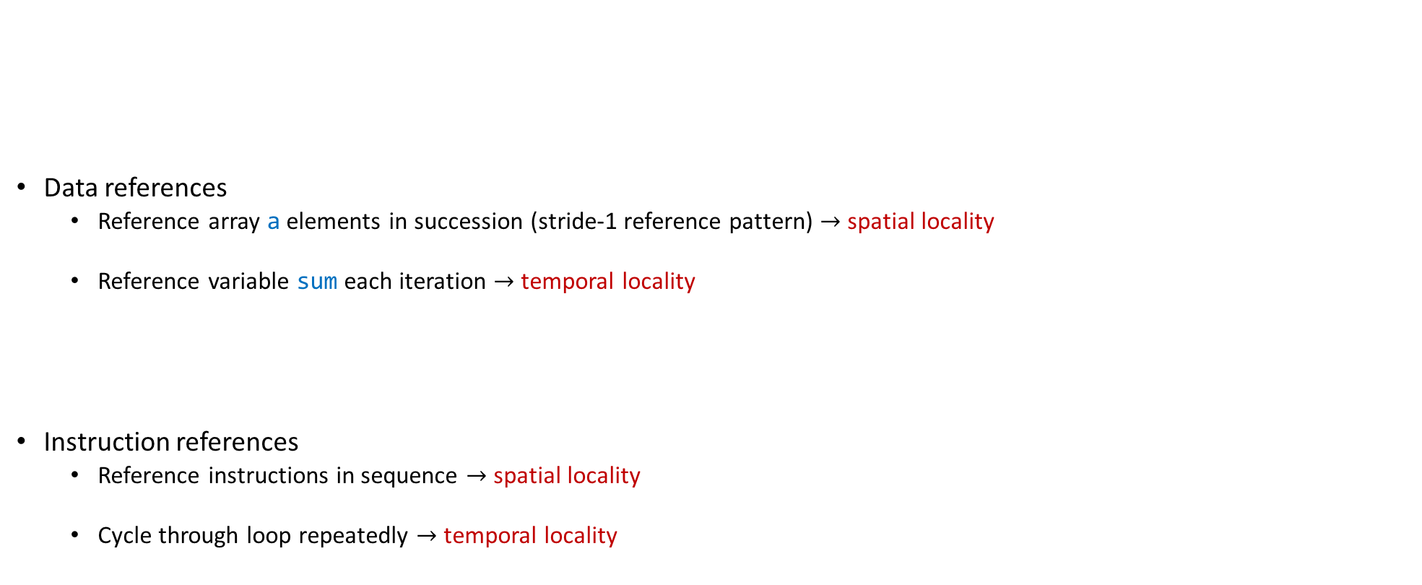
Example, regarding concept of “locality”
sum = 0;
for (i = 0; i < n; i++)
sum += a[i];
return sum;
Data references
Reference array a elements in succession (stride-1 reference pattern) $→$ spatial locality
Reference variable sum each iteration $→$ temporal locality
Instruction references
Reference instructions in sequence $→$ spatial locality
Cycle through loop repeatedly $→$ temporal locality
[Bryant and O‘Hallaron: Computer Systems - A Programmer's Perspective 3rd edition] →

